Slide 1
Hands On Machine Learning
Chapter 05. Support Vector Machine
Junhyeok Shin
ldrugsnw@inha.edu
2024.10.10

Slide 2
INDEX
5.1 Linear SVM Classification
5.2 Non-linear SVM Classification
5.3 SVM Regression

Slide 3
5. Support Vector Machine
Support Vector Machine :
Support Vector Machine (SVM) is a versatile machine learning model that can be used for linear or nonlinear classification, regression, and outlier detection. SVM excels in tasks involving small to medium-sized nonlinear datasets, particularly in classification tasks. However, it does not scale well with very large datasets.

Slide 4
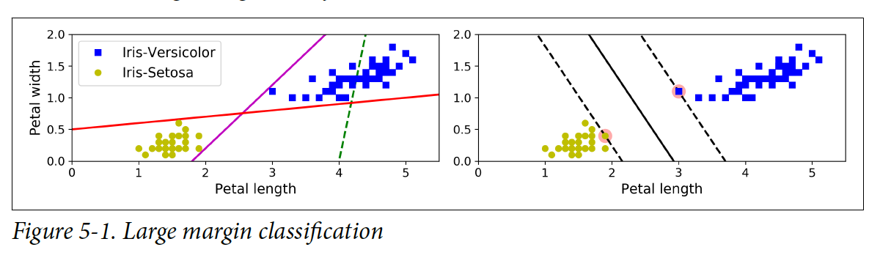
5.1 Linear SVM Classification
With Linear models
With Support Vector Machine
Support vector : dots with a red background
Decision Boundary : solid line
Margin : the space between dashed lines

Slide 5
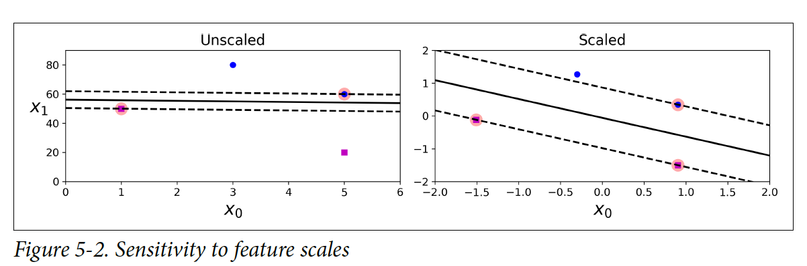
5.1 Linear SVM Classification
이런 식으로 이미지를 넣어야 하거나 내용이 많을 때 사용하면 좋아요!
굳이 핵심내용을 넣을 필요 없을 때도 써도 되구요
상황에 따라 자유롭게 사용해주세요 ✅

Slide 6
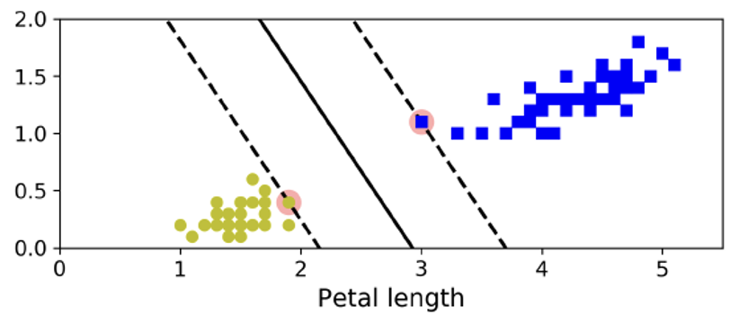
5.1 Linear SVM Classification
Hard Margin Classification
All samples are correctly classified outside the margin.

Slide 7
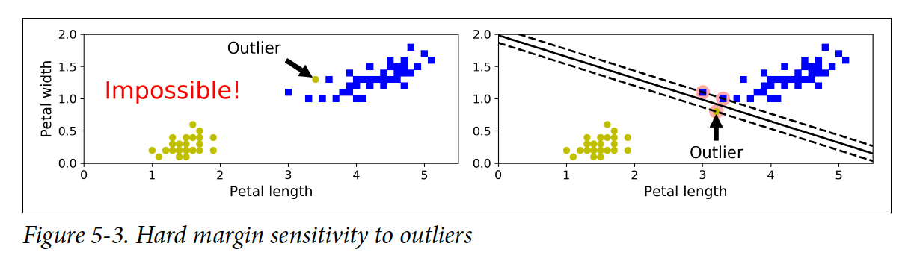
5.1 Linear SVM Classification
But, there are two problems.
It only works well if the data is linearly separable.
It is highly sensitive to outliers.

Slide 8
5.1 Linear SVM Classification
How do we solve this problem?
Soft Margin Classification
A balance must be struck between maximizing the margin width and allowing some margin violations.

Slide 9
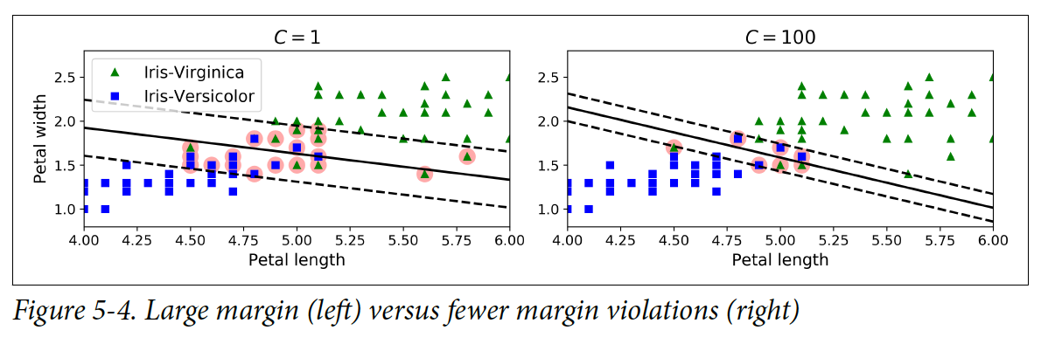
5.1 Linear SVM Classification

Slide 10
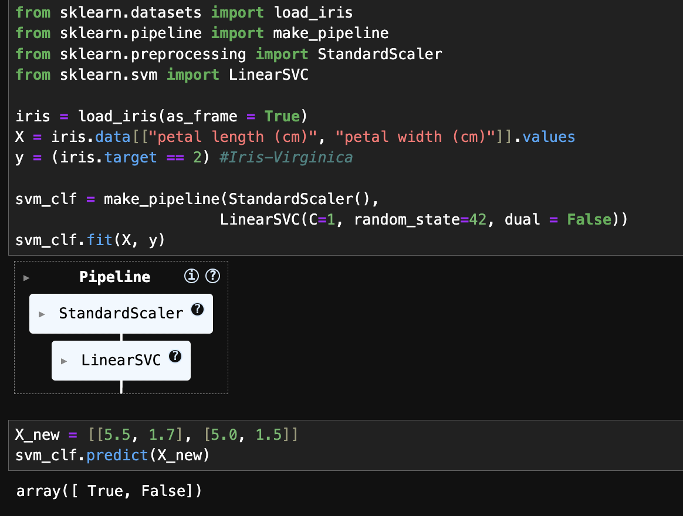
5.1 Linear SVM Classification

Slide 11
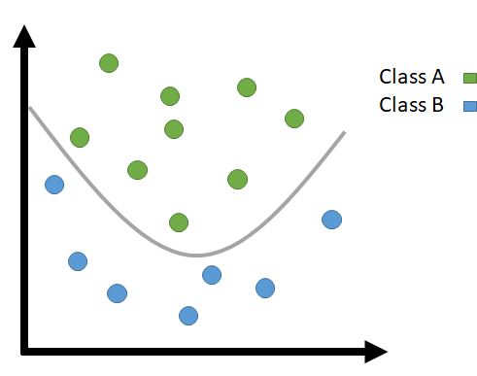
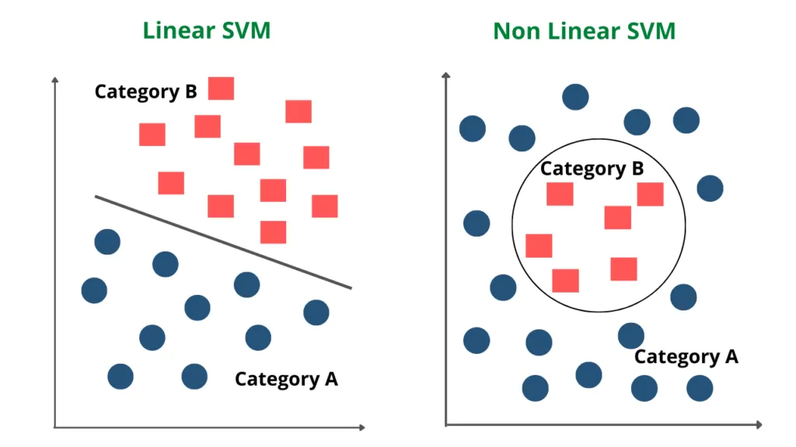
5.2 Non-linear SVM Classification
- While linear SVM classifiers are efficient and perform very well in many cases,
there are many datasets that are not linearly separable.

Slide 12
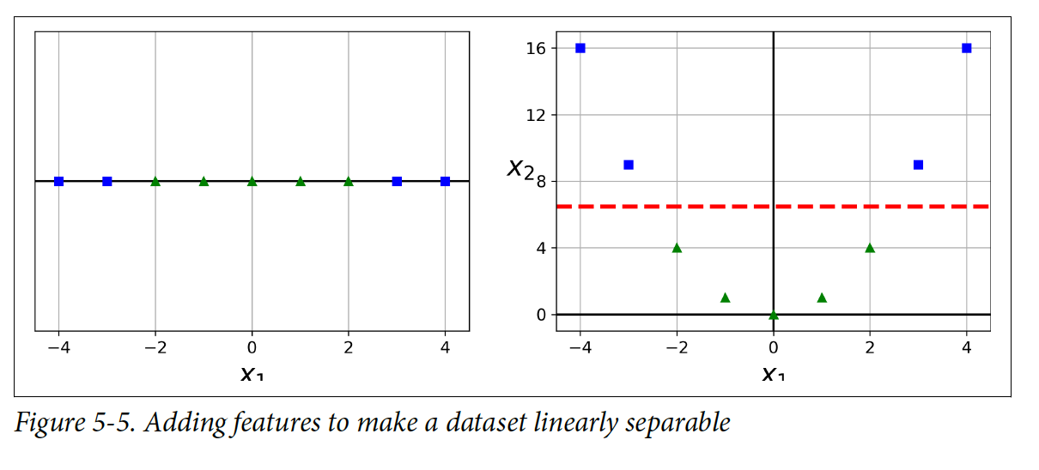
5.2 Non-linear SVM Classification
Add features. => x₂ = (x₁)²

Slide 13
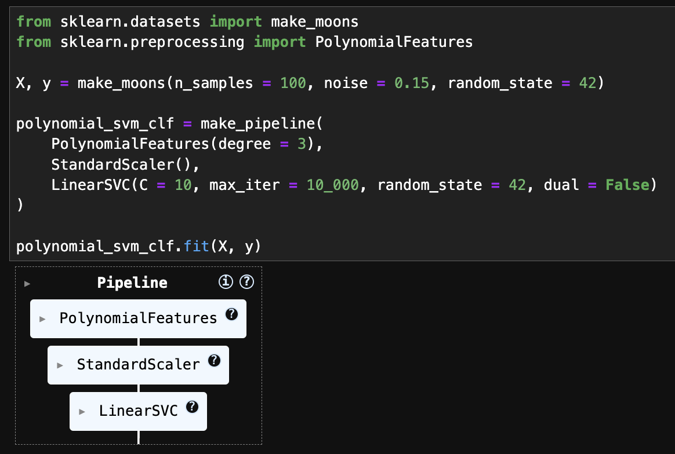
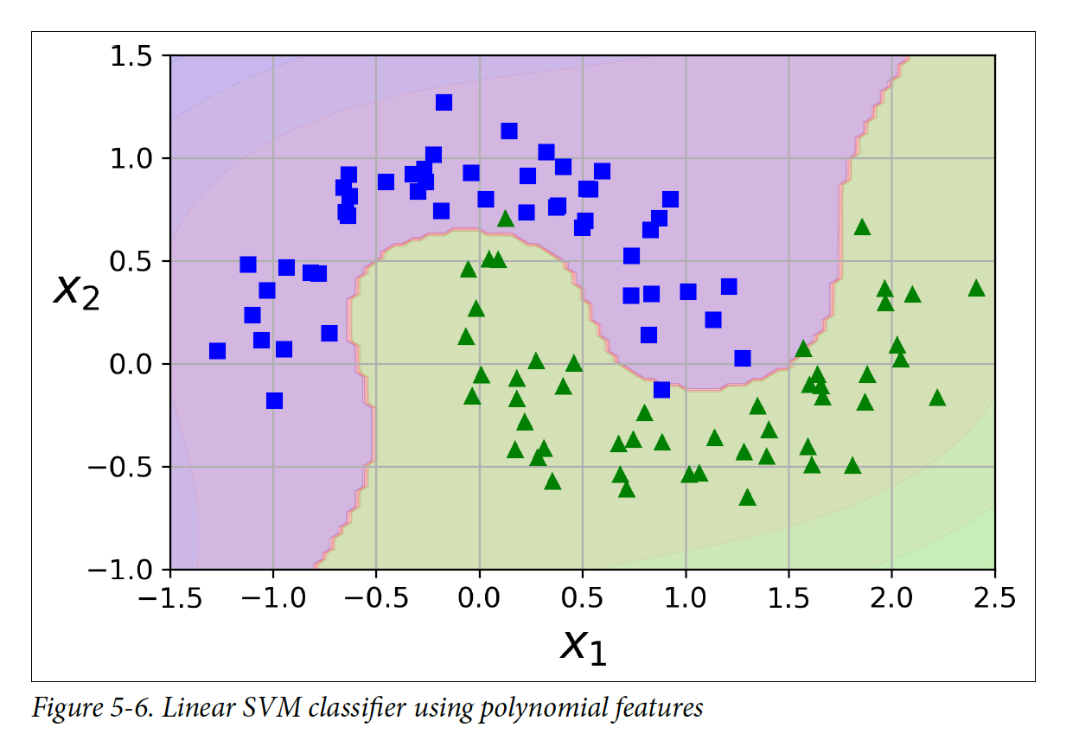
5.2 Non-linear SVM Classification
Code

Slide 14
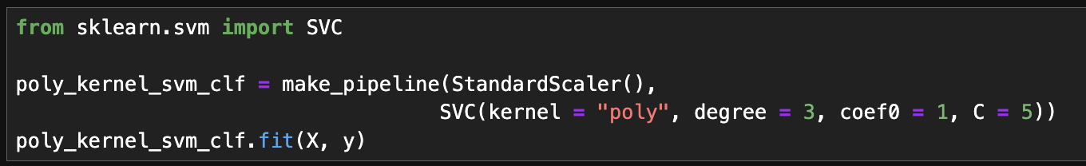
5.2 Non-linear SVM Classification
Adding polynomial features is straightforward and effective.
However, low-degree polynomials may not capture complex datasets well,
while high-degree polynomials can add a vast number of features, slowing down the model.
We can use ‘Kernel trick’.
In SVM, it creates an effect similar to adding many polynomial features
without actually adding features.
coef0 : This parameter adjusts how much the model is influenced
by higher-order and lower-order terms.

Slide 15
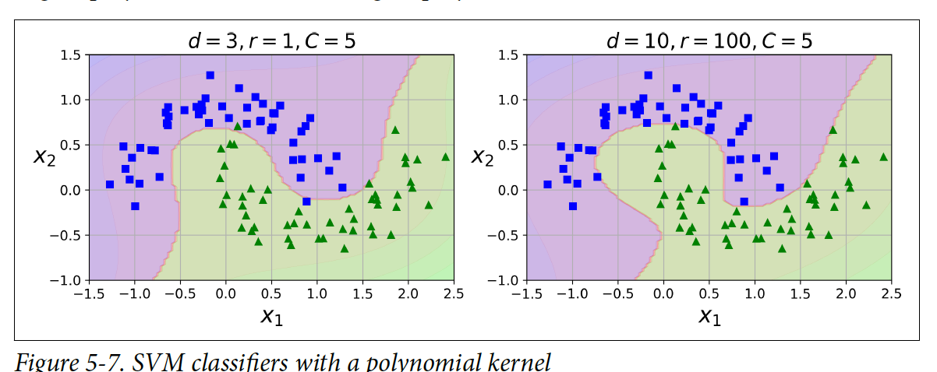
5.2 Non-linear SVM Classification

Slide 16
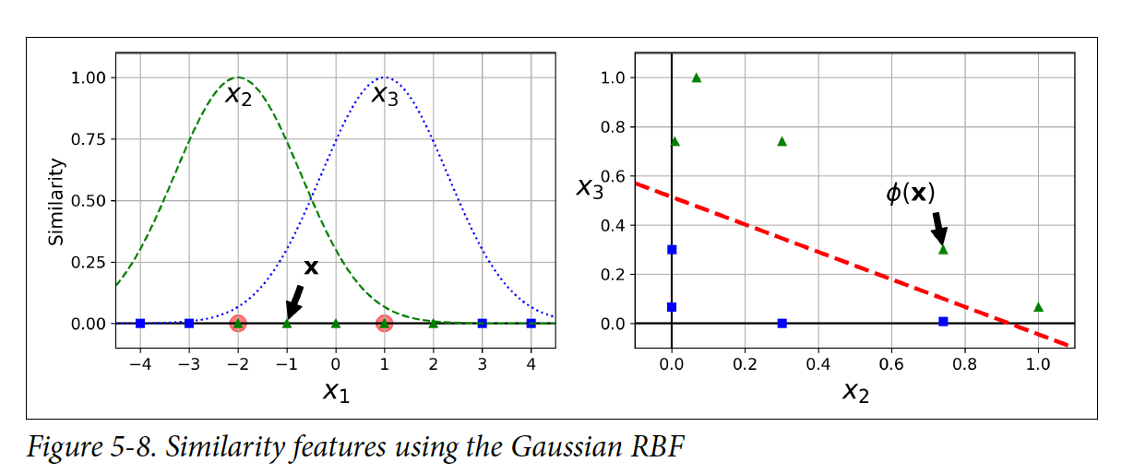
5.2 Non-linear SVM Classification
Gaussian Radial Basis Function (RBF) ϕγ(x, l) = exp(-γ * ||x - l||²)
l: Position of the landmark
x: Position of the sample

Slide 17
5.2 Non-linear SVM Classification
How do we choose landmarks?
Select all samples as landmarks. Impossible!!
When the training set is large, a very large number of features are created,
which slows down the process and increases the risk of overfitting
as the training set becomes linearly separable.

Slide 18
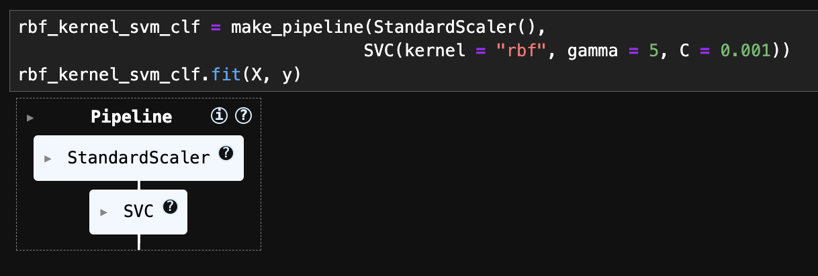
5.2 Non-linear SVM Classification
Gaussian RBF Kernel By using the kernel trick, you can achieve a similar effect as adding many similarity features.

Slide 19
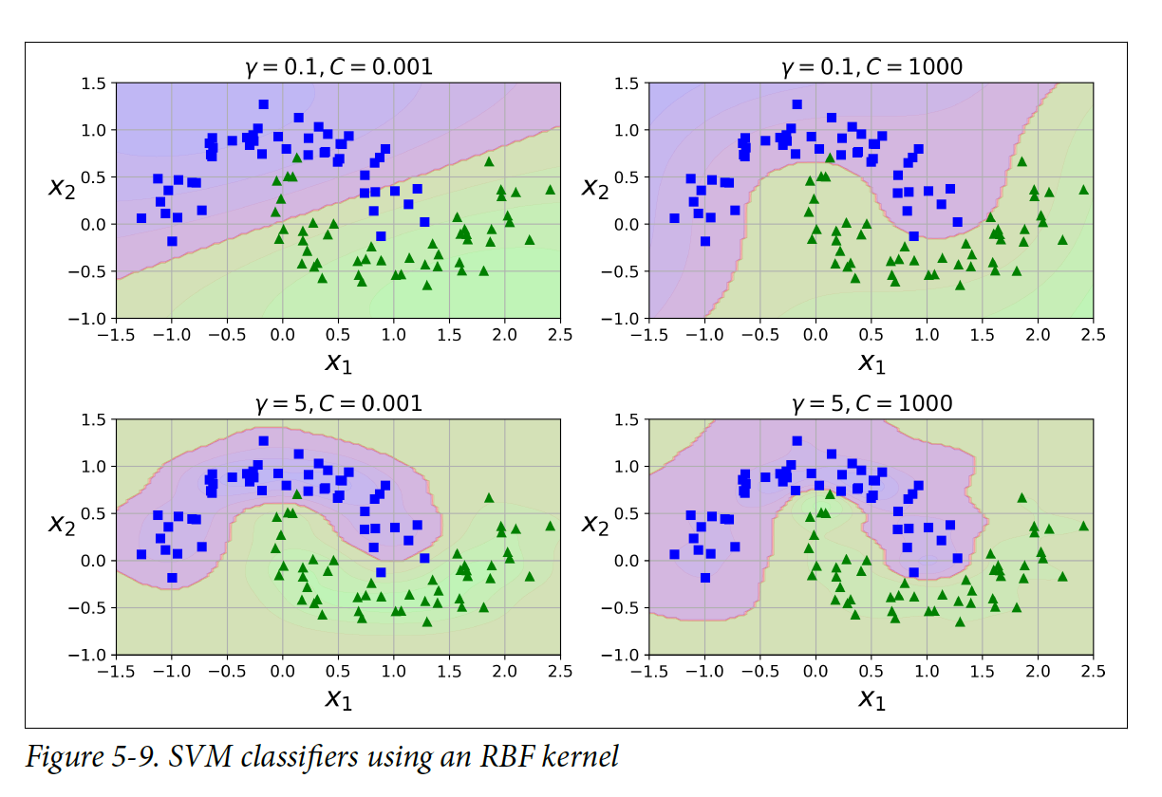
5.2 Non-linear SVM Classification
Gamma: Determines the curvature of the decision boundary.
If the value of Gamma is high, the influence of each data point
is applied only to the nearby neighbors, causing the model
to learn more local patterns.
Conversely, a low Gamma value can lead to the creation of a too simple decision boundary.

Slide 20
5.2 Non-linear SVM Classification
Other kernels are rarely used.
String kernels are occasionally employed for
classifying text documents or DNA sequences
(such as substring kernels or kernels based on
the Levenshtein distance).

Slide 21
5.2 Non-linear SVM Classification
Python Class | Time Complexity | Support for Out-of-Core Learning | Need for Scaling | Kernel trick
LinearSVC | O(m x n) | No | Yes | No
SVC | O(m^2 x n) ~ O(m^3 x n) | No | Yes | Yes
SGDClassifier | O(m x n) | Yes | Yes | No
based liblinear
based libsvm

Slide 22
5.3 SVM Regression
SVM classification goal: To maximize the width of the margin between the two classes
while ensuring that all samples are classified correctly.
SVM regression goal: Instead of maximizing the margin width
between two classes within a certain margin of error,
it learns to include as many samples as possible within the margin,
allowing for limited margin errors.

Slide 23
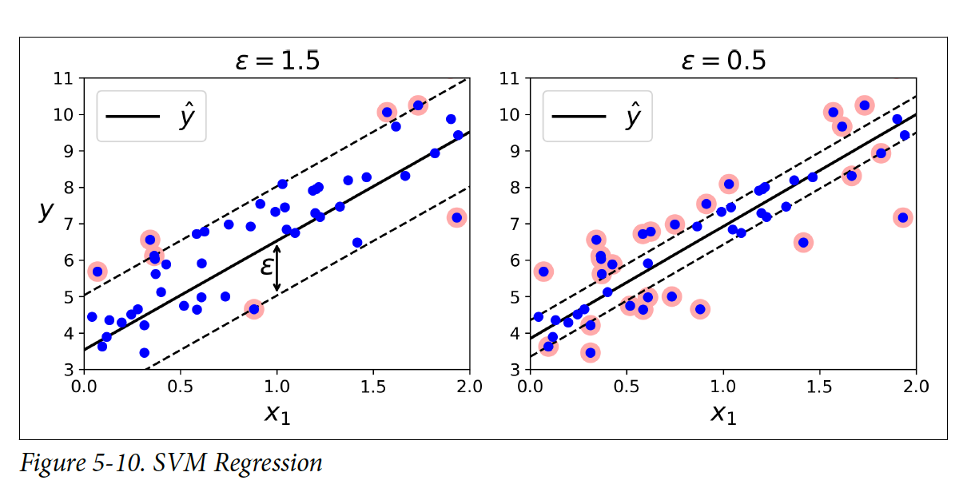
5.3 SVM Regression

Slide 24
5.3 SVM Regression
strong regularization!

Slide 25
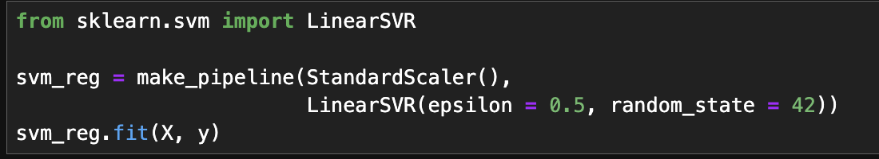
5.3 SVM Regression

Slide 26
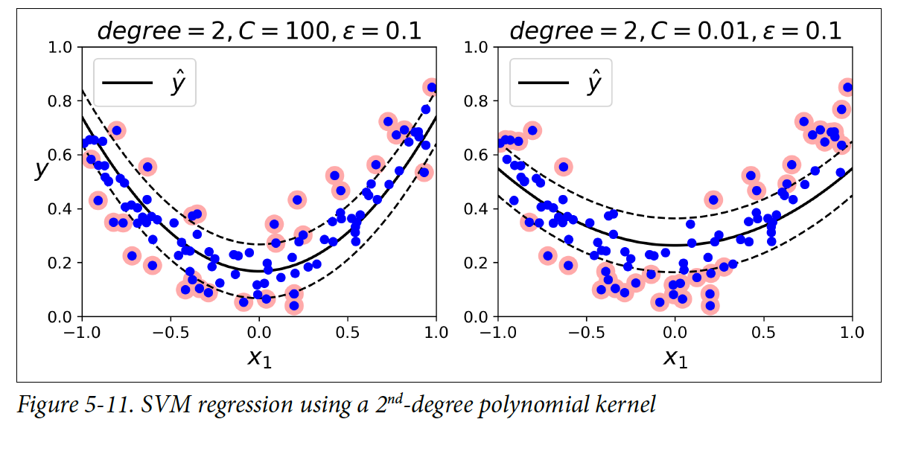
5.3 SVM Regression

Slide 27
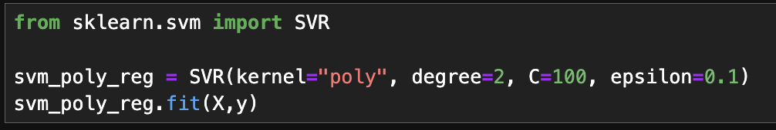
5.3 SVM Regression

Slide 28
Thank You For Listening

